Slide 1


Investigate Business Hotel using Data Visualization
Created by:
Muhammad Aqajahs Al Qarani
Email : jalikarani@gmail.com
LinkedIn : linkedin.com/in/alqarani
Github : github.com/jalikarani
I have a statistical background that is relevant to my major in industrial science. Have an understanding in the fields of data analysis, visualization dashboards, data science, and machine learning with experience in the data field of approximately 3 years accompanied by a certificate of proficiency. Able to process data structurally, starting from data collection, data preparation, data cleansing, pre-processing, modeling, prediction. Some commonly used tools include SQL, Python, PowerBI, Tableu, Looker Studio

Slide 2
Business Understanding
Problem Statement:
A hospitality company needs to analyze customer behavior in hotel bookings and its relationship with the cancellation rate of hotel reservations. We will delve deeper to understand how certain factors influence customer decisions in choosing and canceling hotel reservations.
Goals
To improve operational efficiency and profitability of the hospitality company through a better understanding of customer behavior in hotel bookings and efforts to reduce the reservation cancellation rate.
Objectives
Collect and analyze customer data, including preferences, booking habits, cancellation history, and related information.
Present the findings through visualizations and storytelling.

Slide 3
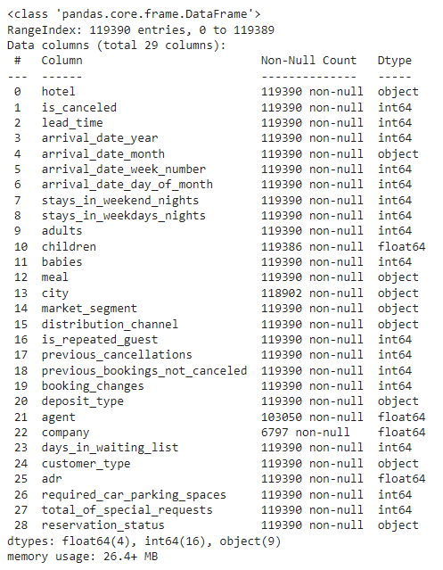
Data Preprocessing
Data Information:
Based on the information provided, there are 29 features with a total of 119,390 rows.
There are missing values in the 'children,' 'city,' 'agent,' and 'company' features.
The data types are as follows: Float64 (4 features), int64 (16 features), object (9 features).
Deskripsi Data :
Upon observation, it's evident that many features have outliers. This can be seen from the difference between the mean and median, as well as the significant gap between the maximum and Q3 (third quartile). Here are some features that show indications of outliers: lead_time, stays_in_weekend_nights, stays_in_weekdays_nights, adults, children, previous_cancellations, previous_bookings_not_canceled, booking_changes, agent, days_in_waiting_list, adr.

Slide 4
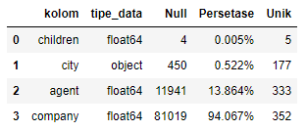
Data Preprocessing
Handling Duplicates:
There are 33,261 duplicate records, which need to be dropped to avoid any inaccuracies in the analysis.
Handling Missing Value :
children: 0.005% (4) of the total data
city: 0.522% (450) missing from the total data
agent: 13.864% (11,941) missing from the total data
company: 94.067% (81,019) missing from the total data
Cara Handling :
For the children feature, it is filled with 0, as it is possible that the customer does not have children.
For the agent feature, it is filled with 0, as there is no agent involvement.
For the company feature, it is filled with 0, as no company is defined.
For the city feature, it will be filled with ‘Unknown’, as the city is not defined.
*Additionally, we will change the data types of numerical features 'children,' 'agent,' and 'company' from float to integer.

Slide 5
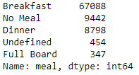
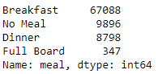
Data Preprocessing
Handling Invalid Value :
If we observe, there is an inconsistent category labeled 'Undefined' in the 'meal' feature. This category is assumed to indicate that customers did not order anything, so it will be categorized as 'No Meal’.
Featues Engineering :
Here, we will check the number of customers based on their orders, so customer categories need to be summed first. Afterward, we will calculate the total orders based on whether they are on weekends or weekdays. This will result in creating new features called "total_guests" and "stay_duration.“
*Next, we will perform filtering to display only the data that has a customer count based on orders (removing rows with a count of 0).
Code selengkapnya bisa di cek disini

Slide 6
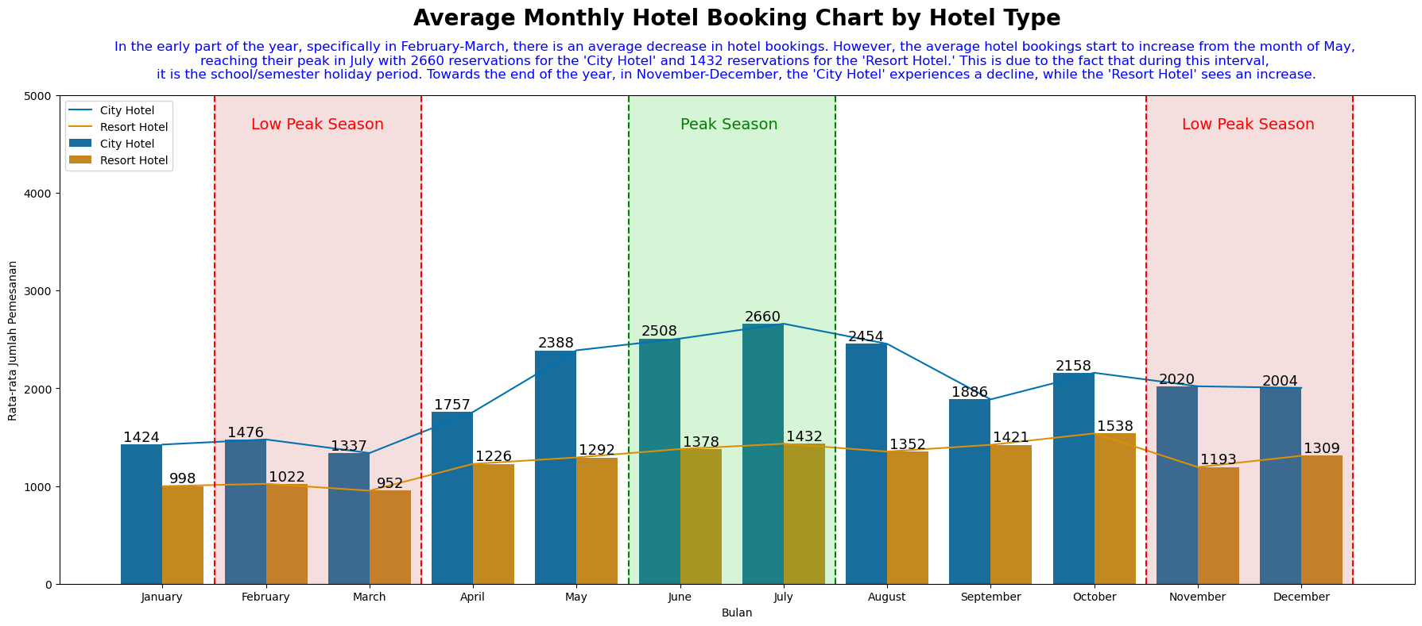
Monthly Hotel Booking Analysis Based on Hotel Type
Masukkan grafik visualisasi pada tugas ini, kemudian tuliskan pula hasil analisismu, insight apa saja yang kamu dapatkan.

Slide 7
Monthly Hotel Booking Analysis Based on Hotel Type
Interpretation:
At the beginning of the year, it can be observed that the average hotel bookings experienced a decline, specifically from February to March. This trend is consistent for both types of hotels. This decrease may be attributed to the start of academic activities in schools/universities and offices, leading to fewer hotel bookings.
The peak increase in average bookings occurs in July, with a continuous rise starting from May to July. During this period, it is the mid-year holiday or mid-semester break, prompting many people to take vacations, resulting in increased hotel bookings.
Towards the end of the year, the trends for city and resort hotels diverge. City hotels experience a slight decrease in average bookings, although not significantly compared to the previous month. Meanwhile, Resort hotels see a slight increase, although it is not highly significant either.
Code selengkapnya bisa dilihat disini

Slide 8
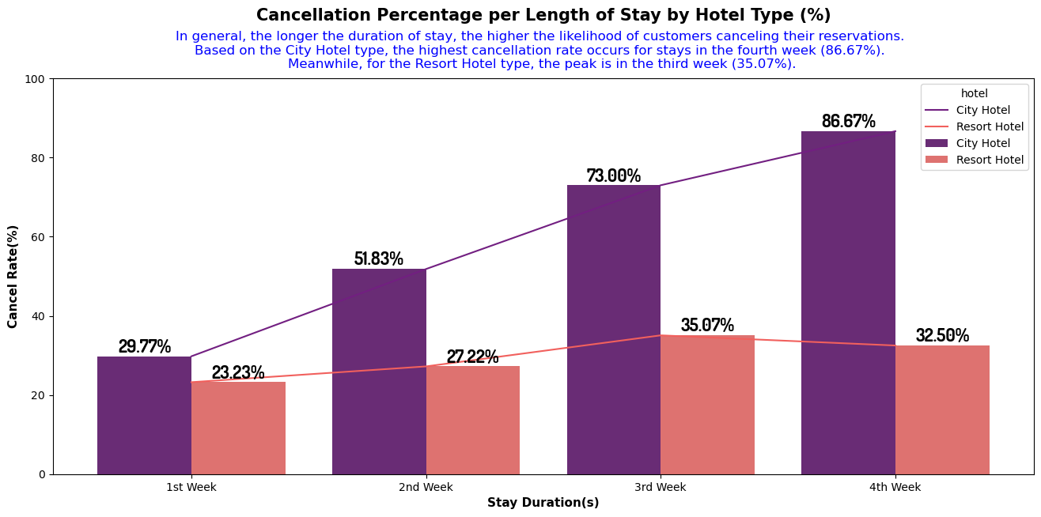
Impact Analysis of Stay Duration on Hotel Bookings Cancellation Rates

Slide 9
Impact Analysis of Stay Duration on Hotel Bookings Cancellation Rates
Interpretation:
Cancellation rates for City Hotels show a significant variation when analyzed based on the length of stay, with a similar but not highly significant trend observed for Resort Hotels.
The highest cancellation rate for City Hotels occurs for stays longer than 4 weeks, whereas for Resort Hotels, the highest cancellation rate is seen for stays of 3 weeks.
Both types of hotels, City and Resort, exhibit a positive correlation between the length of stay and the cancellation percentage. This means that as customers stay for a longer duration, the cancellation rate tends to increase.
Code selengkapnya bisa dilihat disini

Slide 10
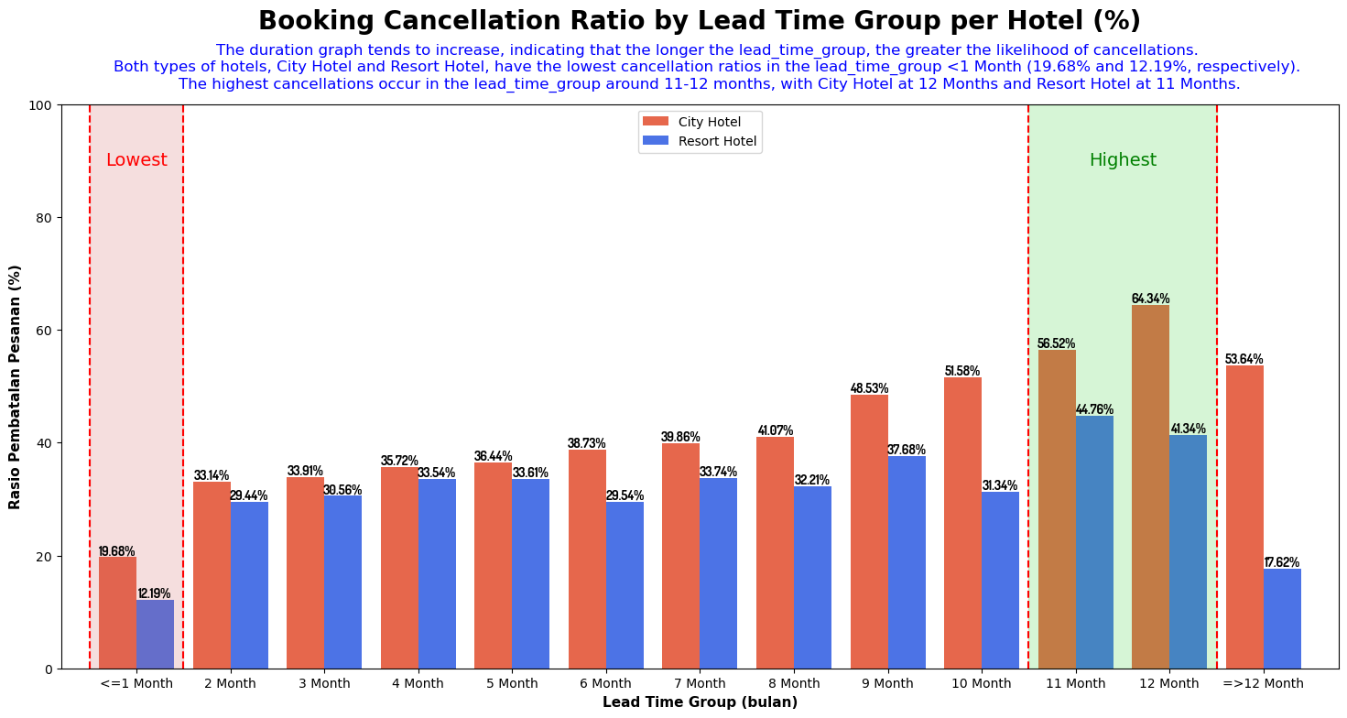
Impact Analysis of Lead Time on Hotel Bookings Cancellation Rate

Slide 11
Impact Analysis of Lead Time on Hotel Bookings Cancellation Rate
Interpretation:
The graph tends to show an upward trend in the data, with a temporary decline for bookings made more than 12 months in advance.
As the lead time for booking increases, the likelihood of cancellation also increases.
Both types of hotels, City and Resort, have the lowest cancellation rates in the 'lead_time_group <1 Month' category, with percentages of 19.68% and 12.19%, respectively.
The highest cancellations occur in the 'lead_time_group around 11-12 months,' with City Hotels at 12 months having a cancellation rate of 64.34%, and Resort Hotels at 11 months having a rate of 44.76%.
Code selengkapnya bisa dilihat disini

